Slide 1

Use Benford’s Law to verify COVID-19 infection report number

Slide 2
Background
For different reasons, people always doubt whether the COVID-19 infection number reported by government is true or integrated. There are many rumors about it and make people nervous about it.
Is there a way to verify the data reported by government? Maybe Benford’s Law can help!

Slide 3
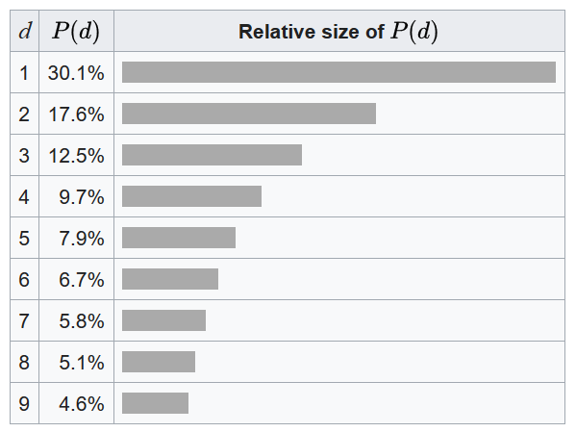

What is Benford’s Law
Benford's law, also called the Newcomb–Benford law, the law of anomalous numbers, or the first-digit law, is an observation about the frequency distribution of leading digits in many real-life sets of numerical data.
A set of numbers is said to satisfy Benford's law if the leading digit d (d ∈ {1, ..., 9}) occurs with probability:

Slide 4
How to get COVID-19 infection number
Tushare is an open platform to query various data.
We can use the open api of Tushare to fetch COVID-19 infection data from 2020-1-24.

Slide 5
Result
First-digit '1' occupy 33.2%
First-digit '2' occupy 16.8%
First-digit '3' occupy 12.6%
First-digit '4' occupy 9.3%
First-digit '5' occupy 7.4%
First-digit '6' occupy 5.9%
First-digit '7' occupy 5.8%
First-digit '8' occupy 4.7%
First-digit '9' occupy 4.3%
Mean Squared Error is 0.010.

Slide 6
Tool
Usage：
java -jar covid.jar [sample files directory path]
Source code:

Slide 7
Reference
Benford's law: https://en.wikipedia.org/wiki/Benford%27s_law
Tushare: https://www.waditu.com/

